Slide 1

Sri Siddhartha Institute of Technology Tumakuru-572105 (A Constituent College of Sri Siddhartha Academy of Higher Education)
Mini-Project(CS5MP1) Presentation On:
Network intrusion detection system

Slide 2


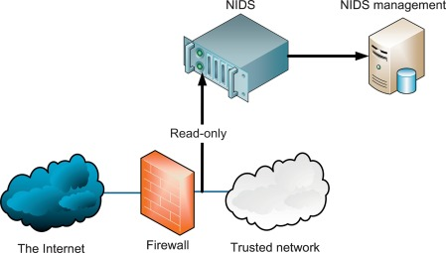
Network intrusion detection system
Done by: CHIRAG P (21CS022) MAAZ PASHA(21CS123)
Under the guidance of: MRS. K NOOR FATHIMA Assistant Professor Department of CSE SSIT, Tumakuru-03 .

Slide 3


CONTENTS
Introduction
Objectives
Problem statement
Literature Survey
ER Diagram
Use Case Diagram
Methodology
Conclusion

Slide 4
Introduction
Importance of Network Security: In today’s digital landscape, safeguarding networks from cyberattacks is paramount. - Network Intrusion Detection Systems (NIDS) serve as vigilant guardians, continuously monitoring network traffic for any signs of malicious activity.
Utilizing Python's Strengths: - Leveraging Python's flexibility and extensive toolset, we aim to develop a robust NIDS. - Python's capabilities in real-time monitoring enable swift detection of anomalies, aiding in the identification of potential threats.
Detection and Response Mechanisms: - Our Python-based NIDS is designed to identify unusual patterns in network data, indicative of potential security breaches. - It not only detects problems but also responds promptly, either autonomously or with human intervention, ensuring swift mitigation of security risks.
Comprehensive Protection: - The NIDS is equipped to combat various threats, including malware, denial-of-service attacks, and unauthorized access attempts. - By proactively addressing emerging threats, our solution aims to fortify network defenses against evolving cyber dangers.
Ease of Use and Adaptability: - Prioritizing usability, we are developing the NIDS to be user-friendly and adaptable to diverse network environments. - Its intuitive interface and adaptability ensure seamless integration into different network infrastructures, enhancing overall security posture.
Ultimate Objective: - Our overarching goal is to enhance network security by employing Python to construct a robust defense mechanism capable of effectively countering evolving cyber threats.

Slide 5
Objectives
Design and implement Python-based NIDS for real-time monitoring.
Integrate advanced algorithms and machine learning for accurate threat detection.
Implement automated response mechanisms and dynamic strategies.
Conduct rigorous testing against diverse datasets and simulated attack scenarios.
Prioritize usability, scalability, and flexibility. - Provide comprehensive documentation and user guides.
Establish continuous improvement framework for ongoing refinement.

Slide 6
Problem statement
Contemporary digital landscape faces escalating cyber threats, posing risks like data breaches and service disruptions.
Current network security measures struggle to keep pace with evolving threats, leading to vulnerabilities.
Critical need for an advanced defense system to proactively identify and mitigate risks
Challenge: Developing a robust Network Intrusion Detection System (NIDS) capable of effectively monitoring network traffic, detecting anomalies, and enabling swift response actions.
Project objective: Address the challenge by leveraging Python's versatile capabilities in networking and cybersecurity.
Focus on usability, flexibility, and effectiveness to empower network administrators with a powerful tool.
Aim: Fortify digital infrastructures against cyber threats, enhancing the resilience of computer networks in today's dynamic security landscape.

Slide 7
Literature survey
Book Title | Author(s) | Description
Intrusion Detection Systems | Rebecca Gurley Bace | Comprehensive overview covering theoretical concepts and practical implementations of intrusion detection.
Network Intrusion Detection: An Analyst's Handbook | Stephen Northcutt, Judy Novak | Insights into methodologies and techniques used by security analysts in detecting network intrusions.

Slide 8
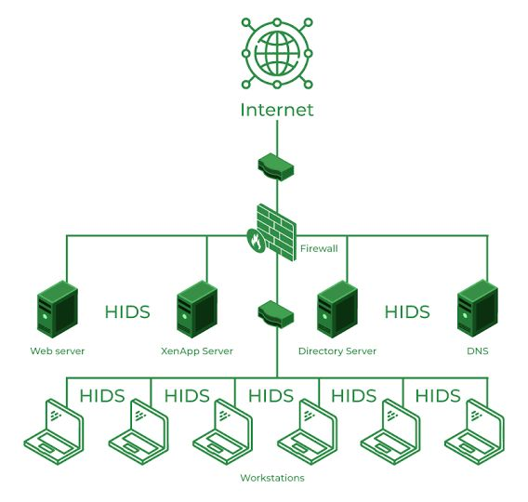
ER Diagram

Slide 9
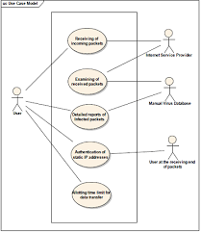
Use case diagram

Slide 10
Methodology 1.Requirement Analysis: Define objectives and identify threats. 2.Data Collection: Gather network data 3.Preprocessing: Clean and prepare data. 4.Model Selection: Choose detection methods. 5.Training: Train models using labeled data. 6.Evaluation: Assess model performance 7.Deployment: Integrate models for real-time monitoring. 8.Testing: Verify detection accuracy. 9.Tuning and Optimization: Fine-tune parameters for better performance. 10.Deployment and Maintenance: Deploy, monitor, and update regularly.

Slide 11
Conclusion
In conclusion, our project to develop a Network Intrusion Detection System (NIDS) reflects our commitment to enhancing network security against modern cyber threats. Through careful planning and diligent work, we’ve crafted a robust system that effectively monitors network traffic and responds to potential threats using Python without relying on complex machine learning techniques. Our NIDS excels at identifying and mitigating various cyber threats, including malware and denial-of-service attacks, leveraging Python’s simplicity and versatility. The thorough testing and evaluation of our NIDS have provided valuable insights, enabling us to refine and optimize its performance for practical use. With real-time monitoring and swift response capabilities, our system empowers network administrators to swiftly detect and address security issues, strengthening the resilience of network infrastructures. Looking ahead, ongoing updates and improvements will be essential to stay ahead of emerging threats and changes in network environments. By staying vigilant and proactive, we’re committed to safeguarding digital assets and ensuring secure communication in today’s interconnected world, all thanks to the power of Python.

Slide 12
Thank you
NETWORK INTRUSION DETECTION SYSTEM by:
CHIRAG P & MAAZ PASHA

